Slide 1
PLACEMENT AND TRAINING (PAT) PROJECT WORK
Name : Jai Indra Reddy Jonnala
Roll no. : 20951A6714
Branch : CSE (Data Science)
Year/Semester : B.Tech III / VI Semester
Mentor : Dr. C V R Padmaja, Associate Professor, IT

Slide 2
FAKE PRODUCT IDENTIFICATION UISNG BLOCKCHAIN TECHNOLOGY
PROJECT TITLE

Slide 3
AGENDA
Problem Statement
Existing System
Proposed System
Objectives
Two Weeks Plan for Implementation
Results
Transactions

Slide 4
PROBLEM STATEMENT
Product counterfeiting is something which is very common now-a-days and it’s almost impossible to detect a counterfeit product just by looking at it. Counterfeiters cause significant challenges for legitimate firms, yet far too many people have no idea of the entire amount of counterfeit items’ influence on brands. There are several methods devised in the past to get away with this problem of product counterfeiting. The most popular methods are using RFID tags, Artificial Intelligence, QR code based systems, etc. But each of them had few disadvantages such as the QR code can be copied from a genuine product and placed on a fake product, artificial intelligence uses CNN and machine learning which needs heavy computational power and so on.
The idea of this project is to improve detection of fake products by tracking its supply chain history. This is achieved with Blockchain technology which ensures the identification and traceability of real products throughout the supply chain. Blockchain based system, makes everything decentralized that may be accessed by several parties at the same time.
One of its main advantages is that the recorded data is difficult to change without the consent of all parties concerned which makes the data extremely secure and protect from all vulnerabilities. This paper presents system designed using blockchain technology for detection of counterfeit products

Slide 5
EXISTING SYSTEM
Base Paper: ITM Web of Conferences 44, 03015 (2022) ICACC-2022 https://doi.org/10.1051/itmconf/20224403015
There are several existing systems and approaches used to detect counterfeit products. Here are a few commonly employed methods:
Physical Security Features
Serial Numbers and Barcodes
Microprinting and UV Markings
Mobile Apps and Authentication Services
Track and Trace Technologies
Chemical Analysis and Forensic Techniques
Market Surveillance and Investigations
Collaboration and Information Sharing

Slide 6
PROPOSED SYSTEM
Counterfeit has spread worldwide and has huge effects on organizations, manufacturers, and consumers. It affects the influence of the organization and the wellbeing of the consumers. India is not excluded. The proposed system is aimed at consumer products, and it helps track the products by maintaining the product and the supply chain integrity by using Blockchain. This gives the customers the power to track the history of the entire product from manufacturer to customer using blockchain and QR code.

Slide 7
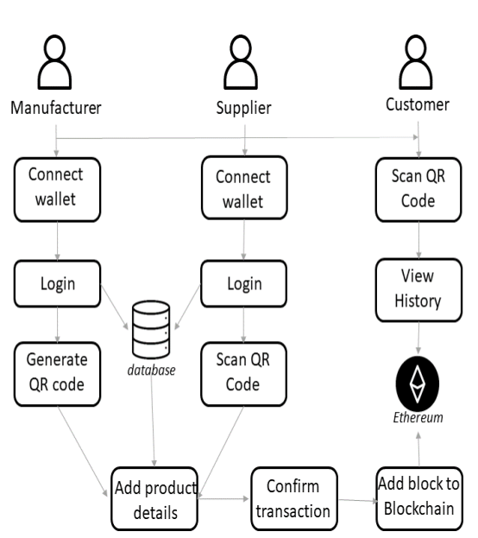
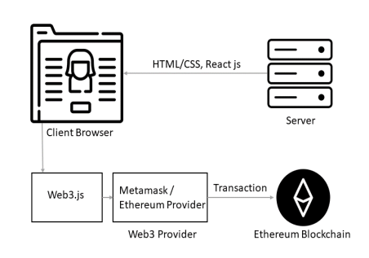
SYSTEM MODEL

Slide 8
OBJECTIVES
The main aim of this proposed system is to maintain the Genuity of the product by helping the customer track the supply chain history of the product. System give customers the power to track the history of an entire product from manufacturer to customer using blockchain. This product anti-counterfeiting system based on Blockchain is composed of three roles, the Manufacturer role, the Seller role, and the Consumer role.
Authenticity Verification
Counterfeit Detection
Supply Chain Transparency
Consumer Protection
Legal and Regulatory Compliance
Collaborative Efforts
Data Security and Privacy

Slide 9
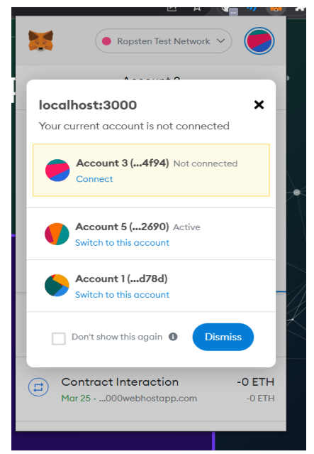
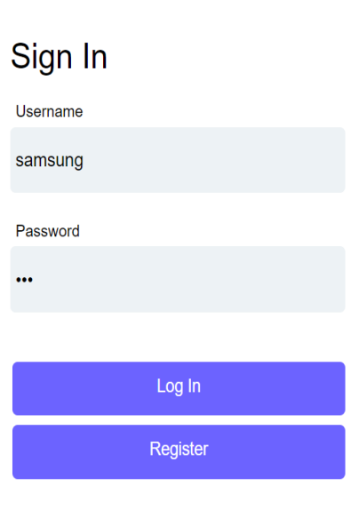
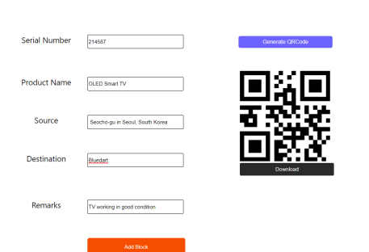
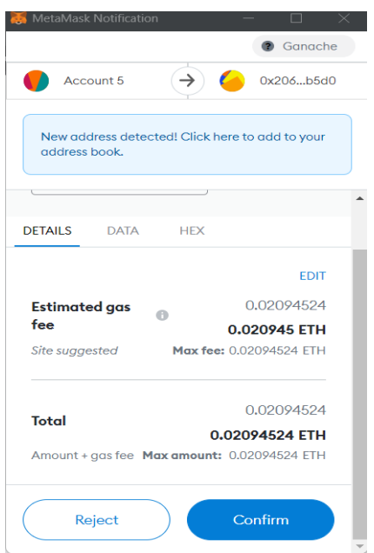
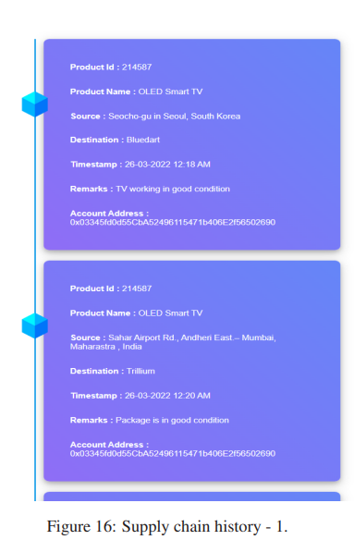
RESULTS

Slide 10
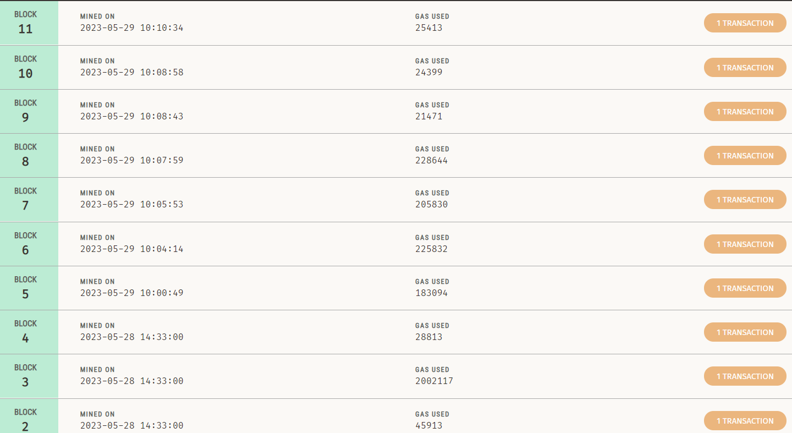
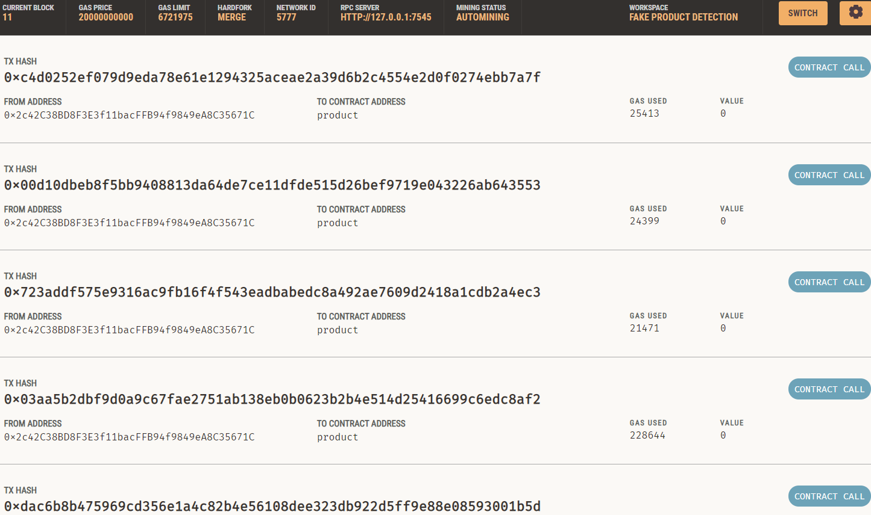
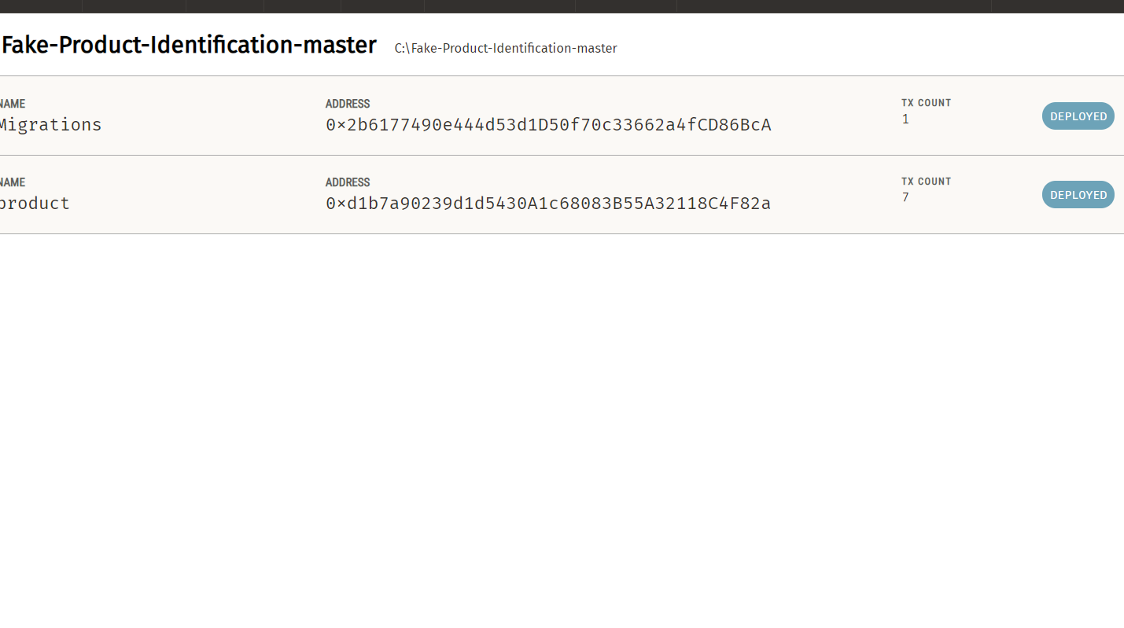
TRANSACTIONS

Slide 11
TWO WEEKS PLAN FOR IMPLEMENTATION
Here is a two-week implementation plan for detecting counterfeit products using blockchain:
Week 1:
Requirement Gathering and Analysis
Blockchain Solution Design
Week 2:
Pilot Testing and Feedback
System Refinement and Optimization
Deployment and Training

Slide 12
REFERENCES
[1] ASPA, The state of counterfeiting in india 2021, https : / / www.aspaglobal.com / pre_upload / nation / 1623216858-4730baa0efdb83aba174859af0a3a6a5- Report % 20The % 20State % 20of % 20Counterfeiting % 20in % 20India % 202021.pdf (2021)
[2] Y. Lu, Journal of Management Analytics 5, 1 (2018)
[3] F. Casino, T.K. Dasaklis, C. Patsakis, Telematics Informatics 36, 55 (2019)
[4] M. Peck, IEEE Spectrum 54, 26 (2017)
[5] S. Idrees, M. Nowostawski, R. Jameel, A. Mourya, Electronics 10, 951 (2021)
[6] Zignuts Technolab, How blockchain architecture works? basic understanding of blockchain and its architecture., https : / / www.zignuts.com / blogs/ how - blockchain - architecture - works - basic - understanding- of- blockchain- and-its- architecture/ (2022)
[7] J. Ma, S.Y. Lin, X. Chen, H.M. Sun, Y.C. Chen, H. Wang, IEEE Access 8, 77642 (2020)
[8] M.J.L.I.N.M. J.M. Bohli, N. Gruschka, IEEE 10, 9 (2013)

Slide 13
THANK YOU

